Slide 1
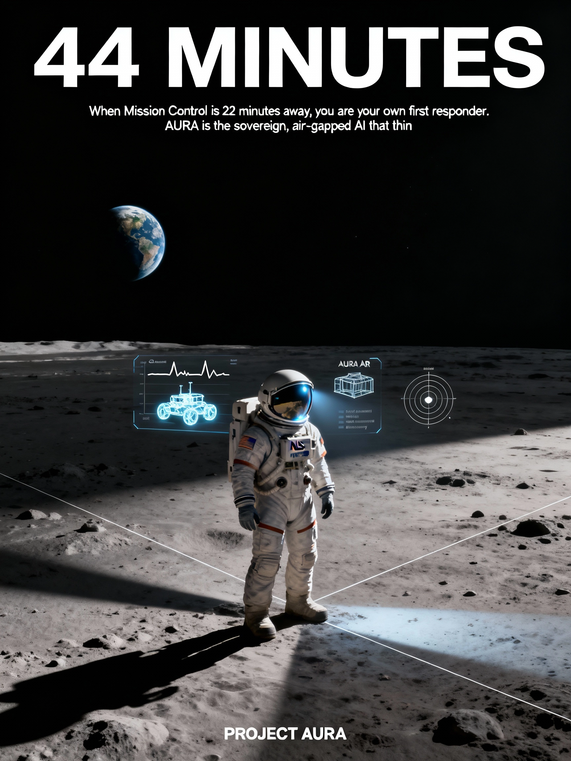

When Mission Control is 22 minutes away, you are your own first responder. AURA is the sovereign, air-gapped AI that thinks with you, not for you.

